Slide 1
Assignment #3 IE5351 Introduction to Systems Engineering
Team II Members
Noran Abulaila
Margaret Adejokun
Lekhya Sindura Nadella
Gopal Penmetsa

Slide 2
Emergent Properties 📲
Part I

Slide 3
Definitions
Emergence
It is the principle that whole entities exhibit properties, which are meaningful only when attributed to the whole, not to its parts (Walden et al., 2015 pg. 68).
Emergent Properties
Properties that emerge as a result of the interactions between system components.

Slide 4
Desirable Emergent Properties
Ability to make phone calls
Connectivity
Audio Output
Audio Input
Visual Output
User Interaction
📡 Carrier
🎧 Headphones
🎙️ Microphone
📱 Screen
📶 VOIP
🔊 Speaker
Bluetooth Devices
Bluetooth Devices

Slide 5
Desirable Emergent Properties
Ability to send and receive text messages
Connectivity
Visual Output
Text Input
User Experience
User Interaction
📡 Carrier
📱 Screen
⌨️ Keyboard
RCS Messages
📶 VOIP
☎️ Dialpad
WhatsApp
Messenger

Slide 6
Desirable Emergent Properties
Ability to play music/stream video (multimedia)
Media Source
Audio Output
Signal Processor
Visual Output
User Interaction
💽 On-Device storage
🎧 Headphones
🏿 DAC
📱 Screen
📻 Streaming
🔊 Speaker
Bluetooth Devices

Slide 7
Desirable Emergent Properties
Ability to capture and store pictures and videos
Image Sensor
Audio Input
Signal Processor
Visual Output
Storage
User Interaction
📷 CMOS sensor &
🔭 Lens housing
🎙️ Microphone
🏿 CPU
📱 Screen
📁 On-Device
storage
Bluetooth Devices
☁️ Cloud Storage
💾 SD card

Slide 8
Desirable Emergent Properties
Ability to navigate using GPS
Connectivity
Navigation Apps
User Interface
User Interaction
🛰️ GPS
Google Maps
🗺️ Map Visualization
📶 Carrier
Apple Maps
🚦Turn-by-Turn Directions
Waze
🥽 AR Navigation

Slide 9
Desirable Emergent Properties
Ability to communicate through the internet
Connectivity
Applications
User Interaction
📡 Wi-Fi
🌐 Web Browser (Chrome, Safari, etc.)
📶 Carrier

Slide 10
Desirable Emergent Properties
Ability to connect to cell phone network provider
Connectivity
Signal Processor
User Interaction
📶 3/4/5 G
🏿 CPU and other chipsets
📶 LTE
📶 GSM

Slide 11
Desirable Emergent Properties
Ability to customize personal preferences
Software
User Interaction
Operating Systems (iOS, Android, etc.)

Slide 12
Undesirable Emergent Properties
The constant need to recharge cell phone battery
🔋 Battery
⚡Surge-Protection Circuit
Power Input
User Interaction
🔌 Charging Port

Slide 13
Undesirable Emergent Properties
Lack of security: The compromise of personal data
Connectivity
Audio Output
Capturing Device
Location
User Interaction
📡 Wi-Fi
🎙️ Microphone
📷 Camera
🛰️ GPS
📶 Carrier
🔊 Speaker
Bluetooth
Bluetooth Devices

Slide 14
Undesirable Emergent Properties
Possibility of physical damage
Input
Output
Computing Circuitry
🔋 Battery
User Interactivity
📲 Capacitive touch
📱 Screen
🏿 CPU, DAC, other chipsets
🎙️ Microphone
🔊 Speaker
🔘 Power and Volume buttons

Slide 15
Causal Loop Model Cell phone project 🤳🏻
Part II

Slide 16
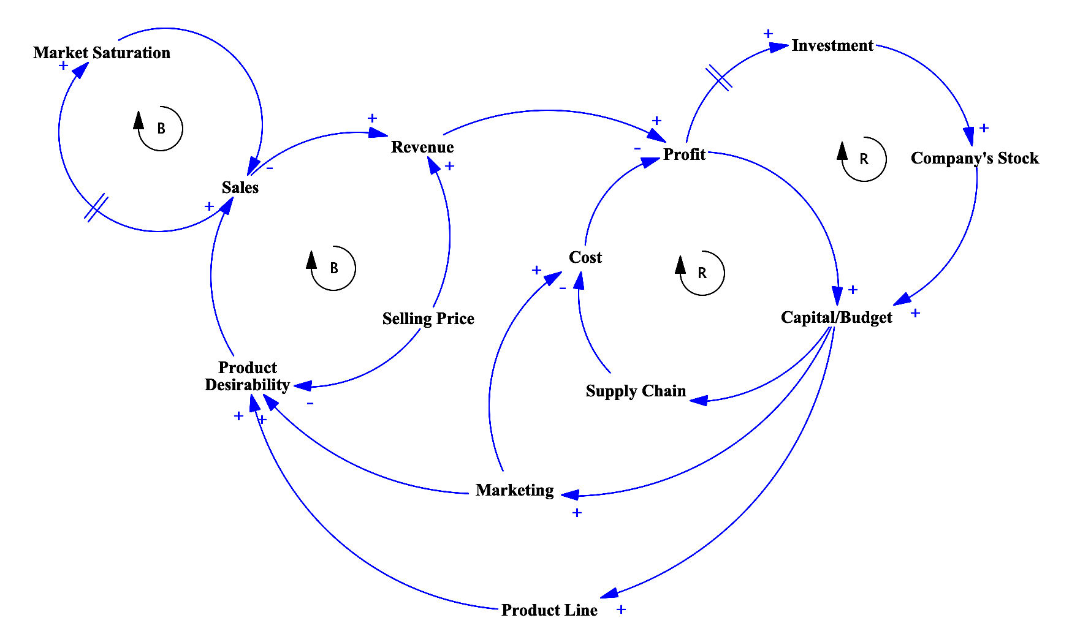
Causal Loop Diagram of a model for examining a new cell phone project

Slide 17
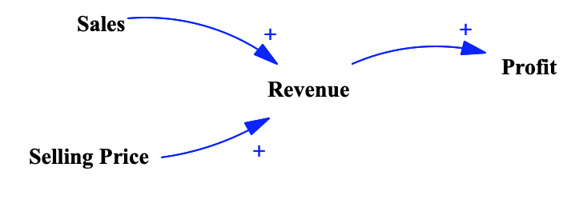
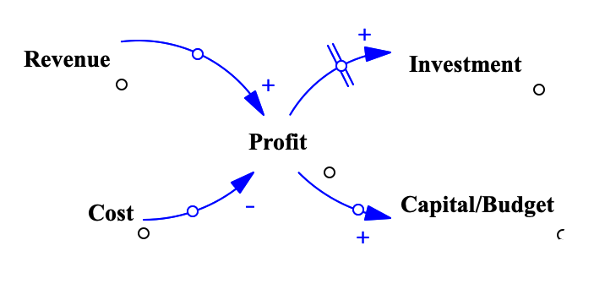
Data Dictionary
Revenue
The money generated from normal business operations, calculated as the average sales price times the number of units sold (Hayes, 2022).
♾ Revenue is positively affected by the Selling price and Sales; it also has a positive effect on the Profit.
Profit
The financial benefit realized when revenue generated from a business activity exceeds the expenses, costs, and taxes involved in sustaining the activity in question (Kenton, 2022).
♾ Profit is positively affected by the Revenue and is negatively affected by the Costs; It positively effects the Budget/Capital and future Investments.

Slide 18
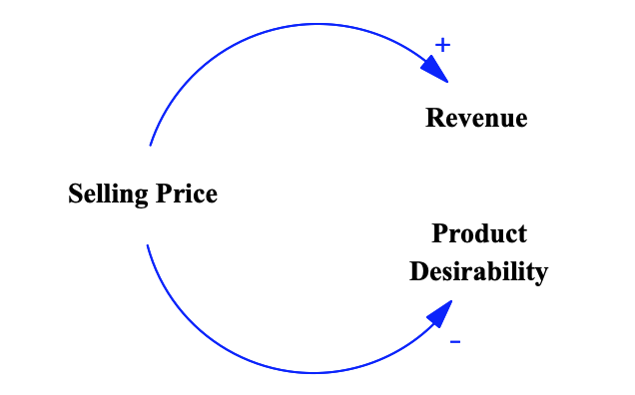
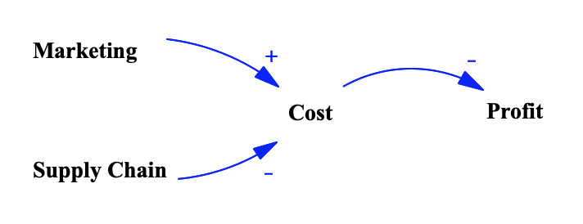
Data Dictionary
Selling price
Price is the amount a customer is paying for a product or service (Murphy, 2022).
♾ Price has a positive effect on the Revenue but negatively affects the Product desirability.
Cost
Cost is the expense incurred for making a product or service that is sold by a company (Murphy, 2022).
♾ Cost is increased by spending in Marketing and can be reduced by improvements in Supply chain; it has a negative effect on the Profit.

Slide 19
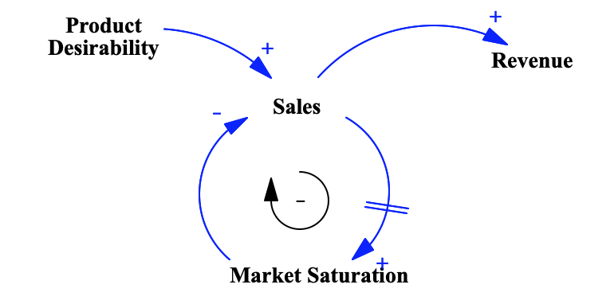
Data Dictionary
Sales
Economic metric that tracks consumer demand for finished goods (Kenton, 2022).
♾ Sales is positively affected by the Product Desirability and has positive effect on the Revenue. It also forms a delayed negative-feedback loop with Market saturation.
Market Saturation
Market saturation arises when the volume of a product or service in a marketplace has been maximized. At the point of saturation, a company can only achieve further growth through new product improvements. (Hargrave, 2022)
♾ Market Saturation is positively affected by increase in Sales and can in-turn negatively impact the further Sale of the product.

Slide 20
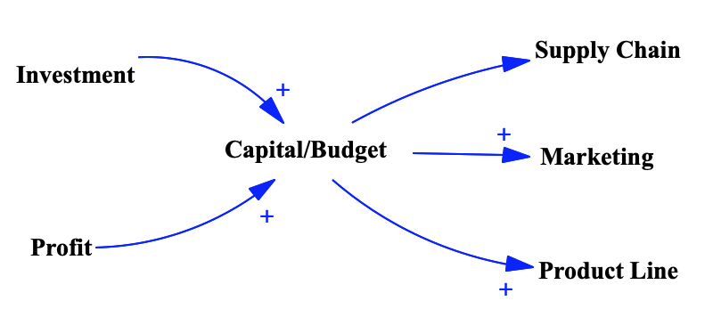
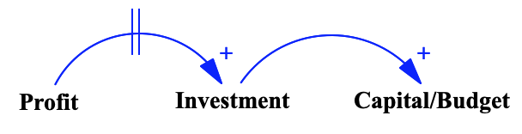
Data Dictionary
Budget/Capital
The money available to fund day-to-day operations and bankroll expansion for the future. (Hargrave, 2022).
♾ Both Profit and Investments have positive effect on the Capital, and It can positively affect (or) be reinvested into factors like Supply chain, Marketing, Product Line.
Investment
Investment is the external funding raised in order to invest in new projects and grow (Team, 2022).
♾ Investment is positively affected by the Profit and can also positively impact the Budget.

Slide 21
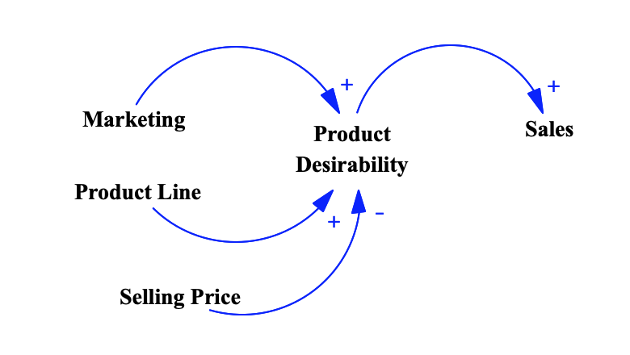
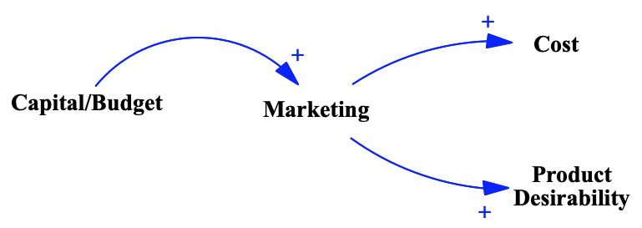
Data Dictionary
Product Desirability
Product Desirability is the evaluation of the product’s merits, and its ability to meet their needs and expectations, especially potential to motivate a user to buy it over other competitor's products (Twin, 2022).
♾ Product desirability is positively affected by Marketing and Product line, and it can be negatively affected by the higher Selling price; it positively effects the Sales of the product.
Marketing
Marketing refers to activities a company undertakes to promote the buying or selling of a product or service (Twin, 2022).
♾ Marketing is positively affect by the available Capital/budget and it can positively affect both the product desirability and the cost.

Slide 22
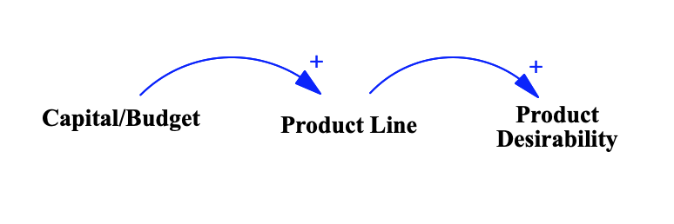
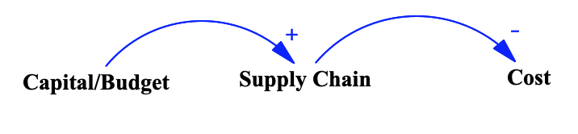
Data Dictionary
Product Line
The money generated from normal business operations, calculated as the average sales price times the number of units sold (Twin, 2022)
♾ Revenue is positively affected by the Selling price and Sales; it also has a positive effect on the Profit.
Supply Chain
A network of individuals and companies who are involved in creating a product and delivering it to the consumer (Hayes, 2022).
♾ Supply chain can be positively affected by investing more Budget and can reduce the Cost.

Slide 23
References
Walden, D. D., Roedler, G. J., Forsberg, K., Hamelin, R. D., & Shortell, T. M. (2015). Systems engineering handbook: A guide for system life cycle processes and activities (pp. 68). Wiley.
Hayes, A. (2022, July 28). Understanding revenue. Investopedia. Retrieved September 5, 2022, from https://www.investopedia.com/terms/r/revenue.asp
Kenton, W. (2022, August 10). Understanding profit. Investopedia. Retrieved September 6, 2022, from https://www.investopedia.com/terms/p/profit.asp
Murphy, C. B. (2022, February 8). The difference between cost and Price. Investopedia. Retrieved September 5, 2022, from https://www.investopedia.com/ask/answers/101314/what-difference-between-cost-and-price.asp
Kenton, W. (2022, February 19). Understanding retail sales. Investopedia. Retrieved September 6, 2022, from https://www.investopedia.com/terms/r/retail-sales.asp
Hargrave, M. (2022, February 8). Market saturation: Taking it to the Max. Investopedia. Retrieved September 5, 2022, from https://www.investopedia.com/terms/m/marketsaturation.asp
Hargrave, M. (2022, August 18). What is capital? Investopedia. Retrieved September 5, 2022, from https://www.investopedia.com/terms/c/capital.asp
Team, T. I. (2022, July 8). What are the sources of funding available for companies? Investopedia. Retrieved September 5, 2022, from https://www.investopedia.com/ask/answers/03/062003.asp
Twin, A. (2022, Sept 2). Product line definition. Investopedia. Retrieved September 6, 2022, from https://www.investopedia.com/terms/p/product-line.asp
Twin, A.. (2022, July 13). Marketing in Business: Strategies and Types Explained . Investopedia https://www.investopedia.com/terms/m/marketing.asp
Hayes, A. (2022, August 16). Supply chain. Investopedia. Retrieved September 6, 2022, from http://www.investopedia.com/terms/s/supplychain.asp

